Slide 1
Medicare 2017
What you need to know

Slide 3
Medicare 2017
Medicare Access and CHIP Reauthorization Act (MACRA)
Podiatry Medicare Data
Evaluation and Management Services
New Codes for 2017
Routine Foot Care

Slide 4
DPMs In Medicare Spending
In 2015, Medicare Part B total allowed charges were $132.9 billion dollars.
Of this total, claims submitted by podiatrists represented $2.16 billion or 1.6 percent.
$20 million Decrease in podiatric allowed charges, that is now 50 million decrease in past 2 years.
Claims submitted by podiatrists represented 1.6% in 2015 dropped from 1.7% in 2014.

Slide 5
Medicare Statute 1965
"Nothing in this title shall be construed to authorize any federal officer or employee to exercise any supervision or control over the practice of medicine, or the manner in which medical services are provided, or over the selection, tenure, or compensation of any officer, or employee, or any institution, agency or person providing health care services...."

Slide 7
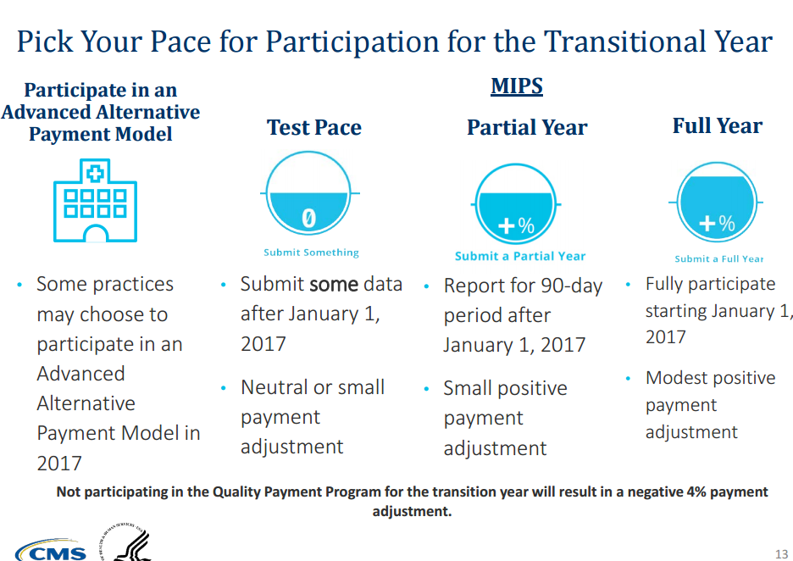

Slide 8
MACRA Quality Payment Program
Merit-Based Incentive Payment System (MIPS)
Alternative Payment Models (APMs)
MIPS and APMs will go into effect over a timeline from 2015 through 2021 and beyond

Slide 9
Who participates in MIPS?
• Medicare Part B clinicians billing more than $30,000 a year and providing care for more than 100 Medicare patients a year.
• These clinicians include:
Physicians
Physician Assistants
Nurse Practitioners
Clinical Nurse Specialists
Certified Registered Nurse Anesthetists

Slide 10
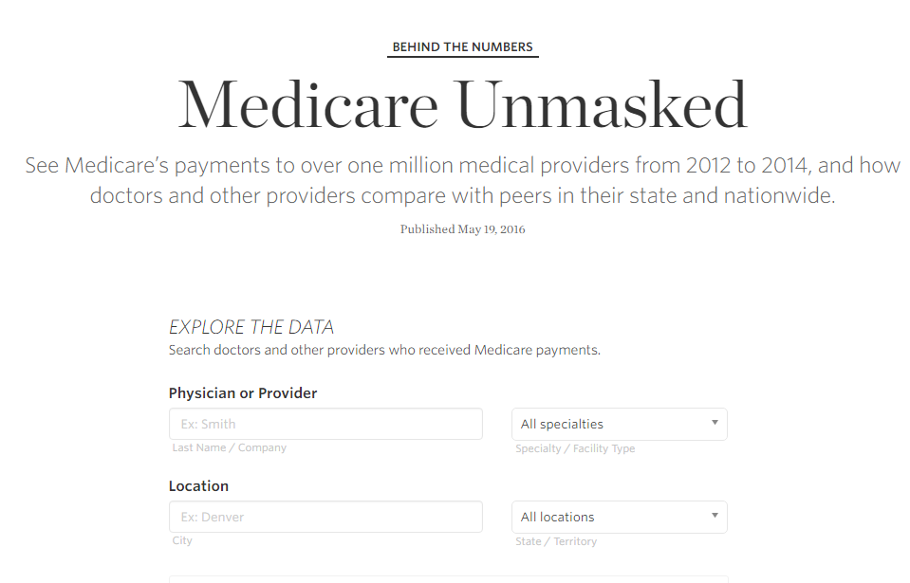
Medicare Billing Data: http://graphics.wsj.com/medicare-billing/

Slide 11
Medicare Data

Slide 12
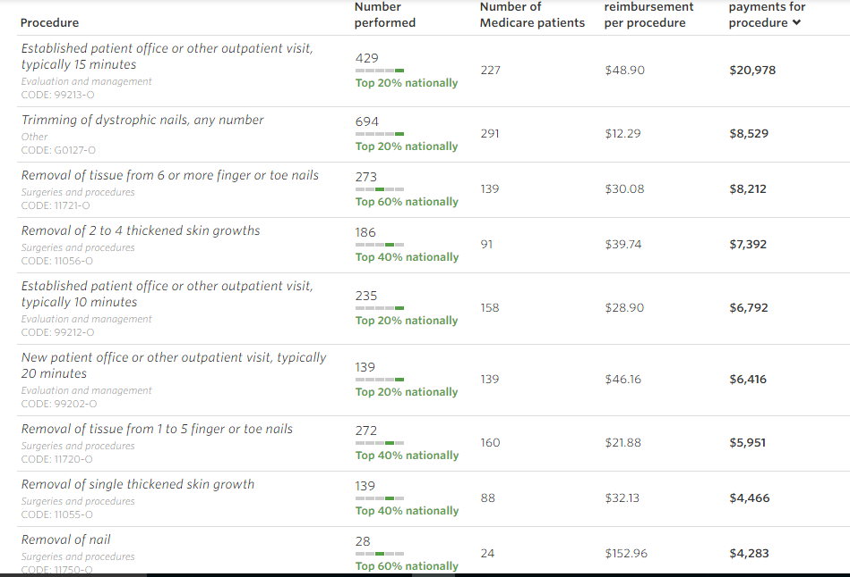

Slide 13
Who is excluded from MIPS?
Newly-enrolled Medicare clinicians - Clinicians who enroll in Medicare for the first time during a performance period are exempt from reporting on measures and activities for MIPS until the following performance year.
Clinicians below the low-volume threshold - Medicare Part B allowed charges less than or equal to $30,000 OR 100 or fewer Medicare Part B patients • Clinicians significantly participating in Advanced APMs

Slide 14
Choosing to Test for 2017
• If you submit a minimum amount of 2017 data to Medicare (for example, one quality measure or one improvement activity), you can avoid a downward adjustment

Slide 15
Partial Participation for 2017
If you submit 90 days of 2017 data to Medicare, you may earn a neutral or small positive payment adjustment.
That means if you’re not ready on January 1, you can choose to start anytime between January 1 and October 2, 2017.
Whenever you choose to start, you'll need to send in performance data by March 31, 2018.

Slide 16
Full Participation for 2017
If you submit a full year of 2017 data to Medicare, you may earn a moderate positive payment adjustment. The best way to earn the largest positive adjustment is to participate fully in the program by submitting information in all the MIPS performance categories.
Key Takeaway: • Positive adjustments are based on the performance data on the performance information submitted, not the amount of information or length of time submitted.

Slide 17
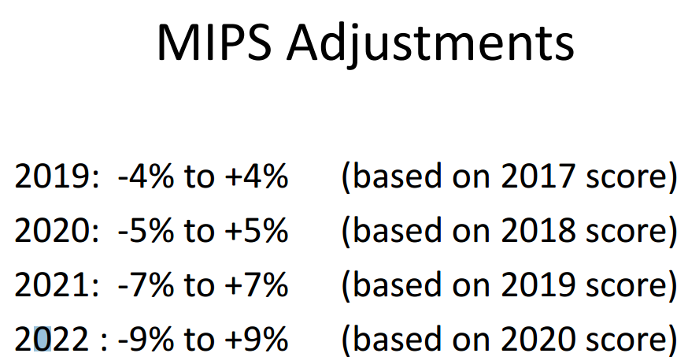

Slide 19
What do you think will be the most likely trend that results from the new CMS guidelines?

Slide 20
Small Practices Have MACRA Anxiety

Slide 21
What is an Alternative Payment Model (APM)?
Alternative Payment Models (APMs) are new approaches to paying for medical care through Medicare that incentivize quality and value.
The CMS Innovation Center develops new payment and service delivery models.

Slide 22
Evaluation and Management Services and Medicare Data

Slide 23
Evaluation and Management Services
1) 99212 ranking has remained 5th
2) 99213 ranking was up to 1st from 2nd
3) 99214 moved up 13th from 19th
4) 99203 remained same, 3rd ranked
5) 99202 remained same,12th

Slide 24
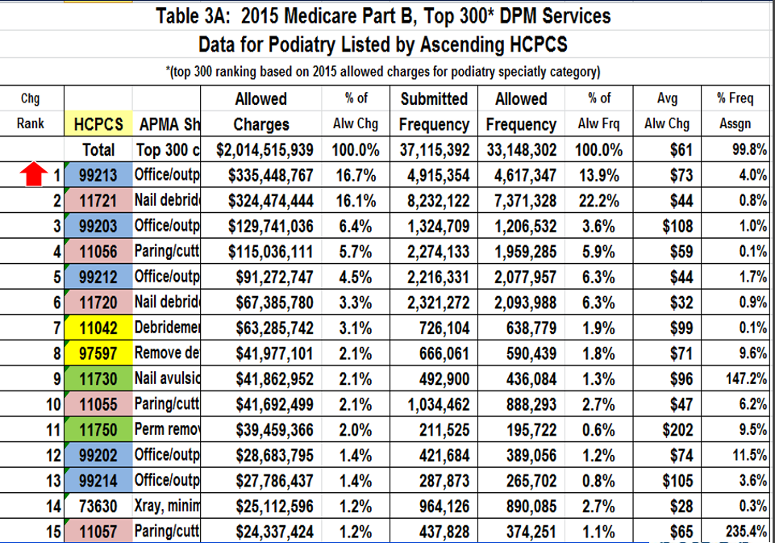

Slide 25
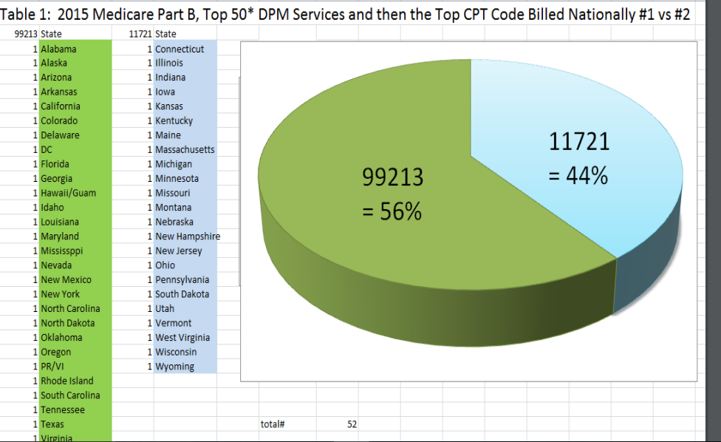

Slide 26
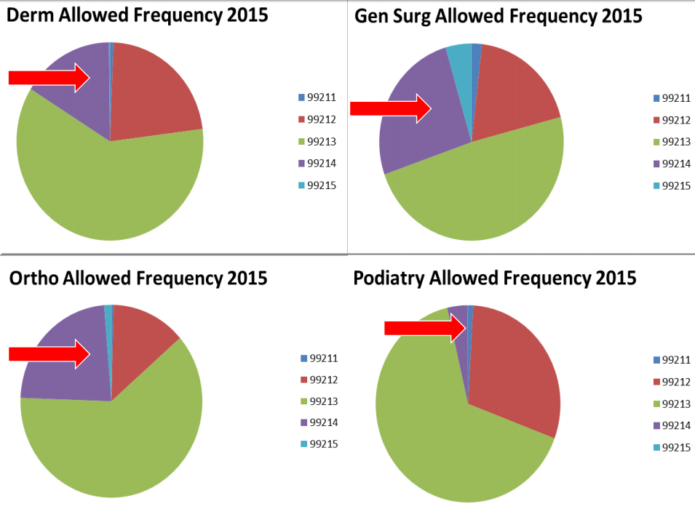

Slide 28
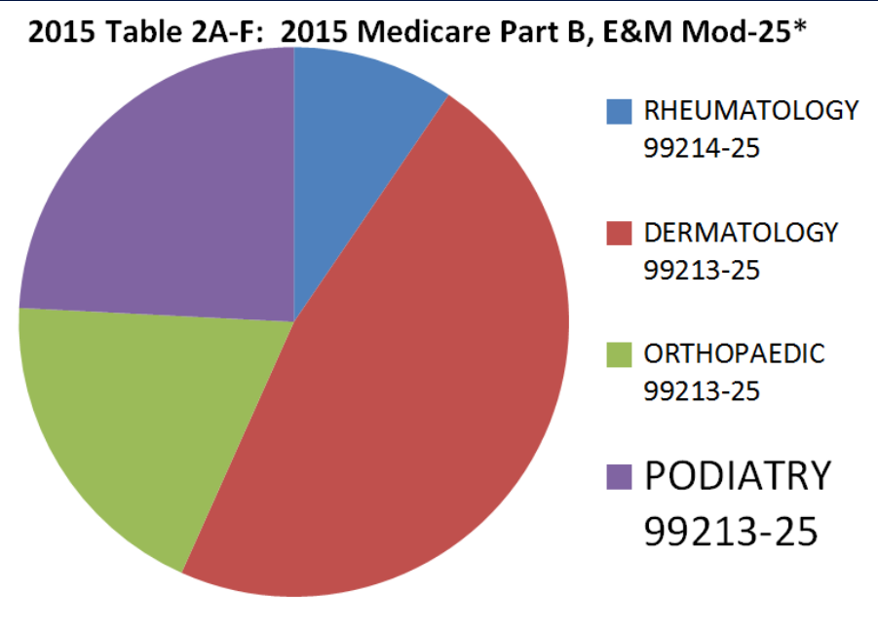

Slide 29
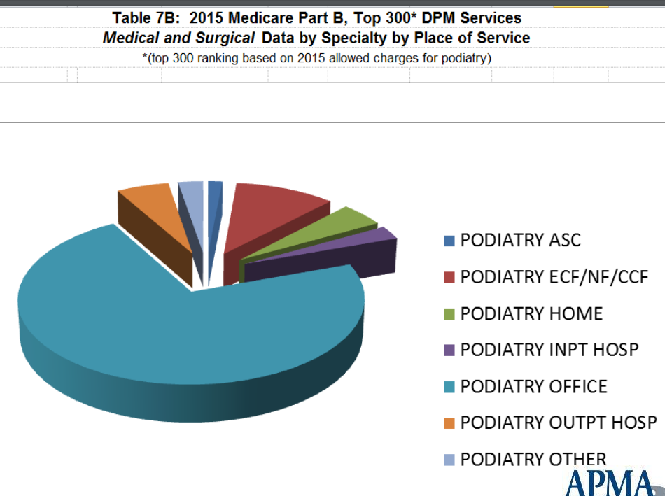

Slide 30
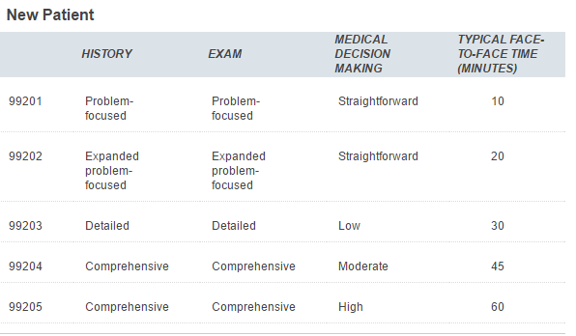

Slide 31
Level 3 New Patient Office Visit (99203)
1) Detailed History
2) Detailed Exam
3) Low Complexity Medical Decision-Making The documentation for this encounter requires THREE out of THREE

Slide 32
Detailed History
History : This 68 y/o male presents to the office as a new patient with pain in both feet. Patient reports pain began one year ago. No acute injury. Pain with every step. He tried OTC insoles that gave minimal relief. Condition is worsening.
Medications: Lisinopril
Allergies: None
ROS General--Negative for fatigue, weight loss, anorexia Cardiovascular--Negative for chest pain, shortness of breath Endocrine--Negative for polyuria, polydipsia, cold intolerance Pertinent PMH is positive for CAD, which has been quiescent

Slide 33
Detailed Physical Exam
Vitals: 120/80, 88, 98.6 Orthopedic: Pain on palpation at insertion of the plantar fascia right and left heel.
Gastroc-soleus equinus. Muscle strength 5/5 of DF, PF, Eversion, Inversion
Cardiovascular: Palpable DP,PT pulses. No peripheral edema or digital cyanosis
Skin: no rash, lesions or ulcers
Neuro: Negative Tinel’s sign posterior tibial nerve bilateral. No of protective sensation. Vibration normal. DTR are 2/4 Achilles and Patellar bilaterally.

Slide 34
Medical Decision Making

Slide 35
New Codes For 2017

Slide 36
New Modifier for X-rays
Beginning January 1, 2017, a 20 percent reduction of the payment amounts under the PFS for the technical component of imaging services that are X-rays taken using film. CMS proposes that beginning January 1, 2017, modifier -FX would be required for X-rays that are taken using film.

Slide 37
Computed Radiography vs Digital Radiography
Reimbursement for Computed Radiography (CR) will be reduced by 7% from 1/1/2018- 12/31/2022 –
Reduction is increased to 10% beginning in 2023 and all subsequent years – No guidance yet on how to report
Anticipate information in 2018 rule making cycle

Slide 38
Bunionectomy: Code Changes for 2017

Slide 39
Bunion codes deleted
CPT 28290 Deleted
CPT 28293 Deleted
CPT 28294 Deleted

Slide 40
Revised Bunionectomy Codes
28292 Correction, hallux valgus (bunionectomy), with or without sesamoidectomy, when performed; with resection of proximal phalanx base, when performed, any method

Slide 41
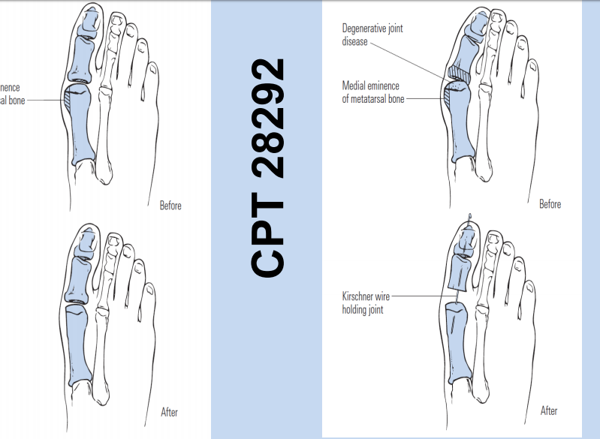

Slide 42
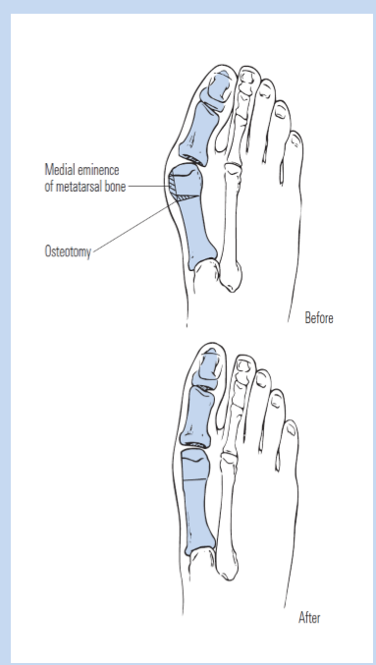
CPT 28296
Correction, hallux valgus (bunionectomy), with or without sesamoidectomy, when performed; with distal metatarsal osteotomy, any method

Slide 43
CPT 28295
Correction, hallux valgus (bunionectomy), with or without sesamoidectomy, when performed; with proximal metatarsal osteotomy, any method

Slide 44
CPT 28298
Correction, hallux valgus (bunionectomy), with or without sesamoidectomy, when performed; with proximal phalanx osteotomy, any method

Slide 45
CPT 28297
Correction, hallux valgus (bunionectomy), with or without sesamoidectomy, when performed; with first metatarsal and medial cuneiform joint arthrodesis, any method

Slide 46
CPT 28299
Correction, hallux valgus (bunionectomy), with or without sesamoidectomy, when performed; with double osteotomy, any method

Slide 47
CPT 28299
Correction, hallux valgus (bunionectomy), with or without sesamoidectomy, when performed; with double osteotomy, any method

Slide 48
CPT 28289
Hallux rigidus correction with cheilectomy, debridement and capsular release of the first metatarsophalangeal joint; without implant

Slide 49
CPT 28291
Hallux rigidus correction with cheilectomy, debridement and capsular release of the first metatarsophalangeal joint; with implant

Slide 51
PODIATRY NATIONAL COVERAGE DETERMINATIONS
Hyperbaric Oxygen Therapy
Consultation Services Rendered by a Podiatrist in a Skilled Nursing Facility
Services Provided for the Diagnosis and Treatment of Diabetic Sensory Neuropathy with Loss of Protective Sensation (a.k.a. Diabetic Peripheral Neuropathy)
Electrical Stimulation (ES) and Electromagnetic Therapy for the Treatment of Wounds

Slide 52
Consultation Services
Consultation services rendered by a podiatrist in a skilled nursing facility are covered if the services are reasonable and necessary and do not come within any of the specific statutory exclusions.
The Act excludes payment for the treatment of flat foot conditions, the treatment of subluxations of the foot, and routine foot care

Slide 53
Consultation Services
The exclusion of routine physician examinations is also pertinent and would generally exclude podiatric consultation performed on all patients in a skilled nursing facility on a routine basis for screening purposes, except in those cases where a specific foot ailment is involved

Slide 54
Diagnosis and Treatment of Diabetic Sensory Neuropathy with Loss of Protective Sensation
Medicare covers, as a physician service, an evaluation (examination and treatment) of the feet no more often than every six months for individuals with a documented diagnosis of diabetic sensory neuropathy and LOPS, as long as the beneficiary has not seen a foot care specialist for some other reason in the interim

Slide 55
Loss of Protective Sensation
1. A patient history,
2. A physical examination that must consist of at least the following elements: • Visual inspection of forefoot and hindfoot (including toe web spaces); • Evaluation of protective sensation; • Evaluation of foot structure and biomechanics; • Evaluation of vascular status and skin integrity; • Evaluation of the need for special footwear
3. Patient education

Slide 56
Treatment includes, but is not limited to:
Local care of superficial wounds;
Debridement of corns and calluses; and
Trimming and debridement of nails.

Slide 57
PODIATRY LOCAL COVERAGE DETERMINATIONS
LCD for Routine Foot Care and Debridement of Nails (L33636)
LCD for Incision and Drainage (I & D) of Abscess of Skin, Subcutaneous and Accessory Structures (L33563)
LCD for Debridement Services (L33614)
LCD for Nonvascular Extremity Ultrasound (L33619)

Slide 58
MEDICAL REVIEW FOCUS AREAS
EVALUATION AND MANAGEMENT SERVICE WITH MODIFIER 25 BILLED WITH NAIL DEBRIDEMENT - CODES 11720 AND 11721
CPT code 99310 (subsequent nursing facility care) for Illinois, Minnesota and Wisconsin (Jurisdiction 6) is 92.2% higher than the national average.
Part B Medical Review Department for J6 performed a widespread service specific probe review of code 99348 (Home visit)
Sclerotherapy services in Jurisdiction 6 is 61.5% higher than the national average. The payment for sclerotherapy services in these states is 12.2% of the national total, while enrollment is 7.1% of the national total.

Slide 59
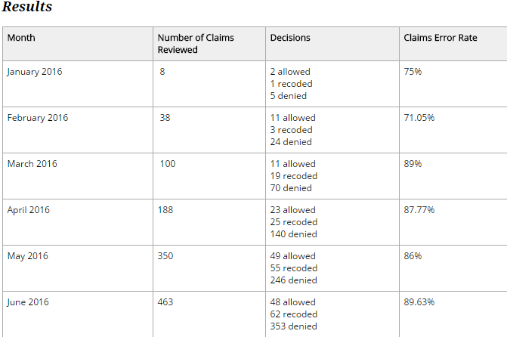
MODIFIER 25 SERVICE SPECIFIC PREPAYMENT REVIEW

Slide 60
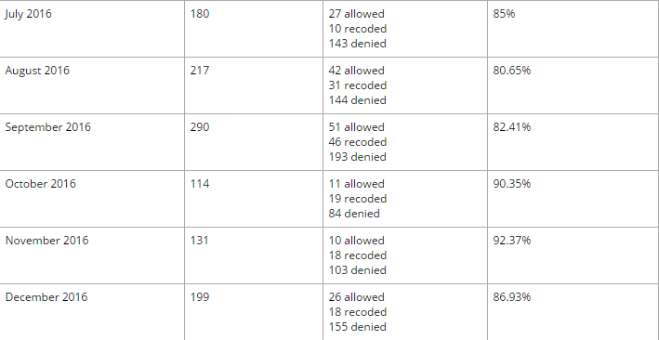
MODIFIER 25 SERVICE SPECIFIC PREPAYMENT REVIEW

Slide 61
Primary Problems Identified and Recommendations for Improvement
An E&M service billed on the same day as nail debridement is not eligible for reimbursement unless the medical record clearly supports the need for treatment of an unrelated problem.
Hygienic and preventive maintenance care in the realm of self-care is considered to be a component of custodial care and therefore is not covered.
If nail debridement was performed because of a fungal infection, ordering antifungal medication is usually considered integral to the nail debridement procedure and part of the definitive antifungal treatment options. A separate E&M service will not be allowed.

Slide 62
Modifier -25: Appropriate Use
A patient is scheduled by the podiatrist to take care of a fibrous hamartoma. During the visit, the patient indicates that he has had numbness and oozing from a lesion on his heel. The podiatrist evaluates the lesion, determines that it is a diabetic ulcer and treats it appropriately. ▪ In this case the heel lesion is considered a separate and significant service.

Slide 63
Modifier -25: Inappropriate use
An established patient is seen in the office for debridement of mycotic nails. In the course of examining the feet prior to the procedure, Tinea Pedis is noted. Use of previously prescribed topical cream to treat the Tinea is recommended.
In this case the Tinea was noted incidentally in the course of the evaluation of the mycotic nails and did not constitute a significant and separately identifiable E&M service above and beyond the usual pre and post care associated with nail debridement.

Slide 64
Prepayment Review Results 2016 99348, 99349, 99350
October: 84 total claims billed; 70 (83.33%)were reduced or denied
November: 205 total claims billed; 180 (87.80%) were reduced or denied December: 224 total claims billed; 193 (86.16%) were reduced or denied

Slide 65
Prepayment Review Results for October, November, December 2016
Incomplete/illegible documentation
Billing visit in lieu of routine foot care, debridement
Visits reported with modifier 25 indicating the E&M was a significant, separately identifiable service (documentation lacked data)
Missing physician’s signature on submitted documentation
Duplicate services

Slide 66
Prepayment Review Results for October, November, December 2016
Documentation submitted did not support key components of code
Beneficiary name and or date of service was missing on documentation
No response to the documentation request
Place of service 16 (temporary lodging) was being billed for visits/services rendered in the patient’s home

Slide 67
Questions

