Slide 1
Coding for Wound Care in 2017: Updates and Changes
Lawrence A. Santi, DPM, FASPS
Member, APMA Coding Committee

Slide 2
Ulcer & Wound Grading
Wagner – 6 Grades
UTSA – Lesion Depth with both Ischemia & Infection (Stage A-D, Grade 0-III)
Pressure – 4 +2
Doesn’t matter which system you use as long as you describe the ulcer adequately

Slide 3
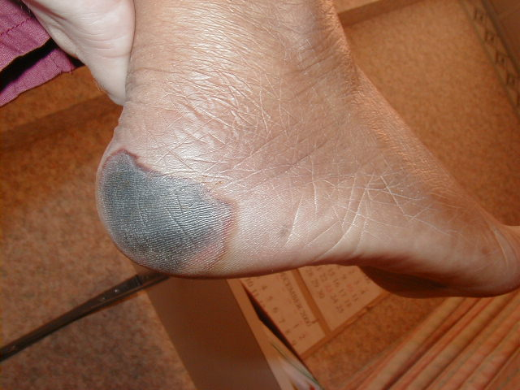
Pressure Ulcer Grading System
Adopted in Feb. 2007 by the National Pressure Ulcer Advisory Panel:
Suspected Deep Tissue Injury - Purple or maroon area of discolored intact skin or blood-filled blister.

Slide 4
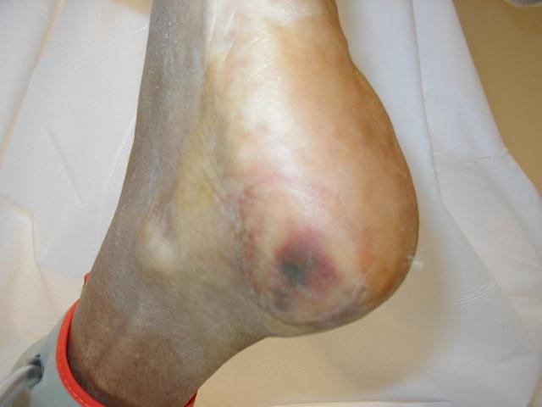
Pressure Ulcer Grading System
Stage 1 – Intact skin with non-blanchable redness or a localized area usually over a bony prominence.

Slide 5
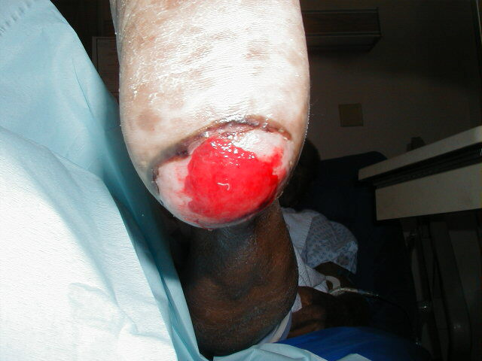
Pressure Ulcer Grading System
Stage 2 – Partial thickness loss of dermis presenting as a shallow open ulcer with a red pink wound bed.

Slide 6
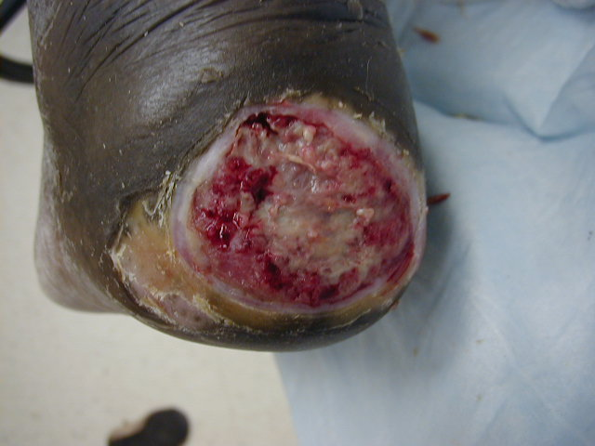
Pressure Ulcer Grading System
Stage 3 – Full Thickness tissue loss. Subcutaneous fat may be visible, but bone, tendon or muscle must not be exposed.

Slide 7
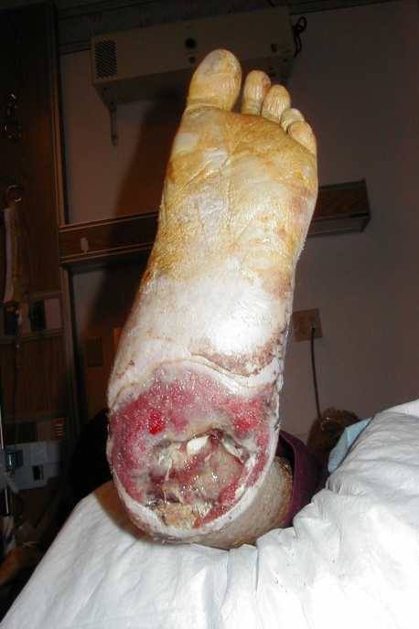
Pressure Ulcer Grading System
Stage 4 – Full Thickness tissue loss with exposed bone, tendon, or muscle. Slough and eschar may be present on some parts of the wound bed.

Slide 8
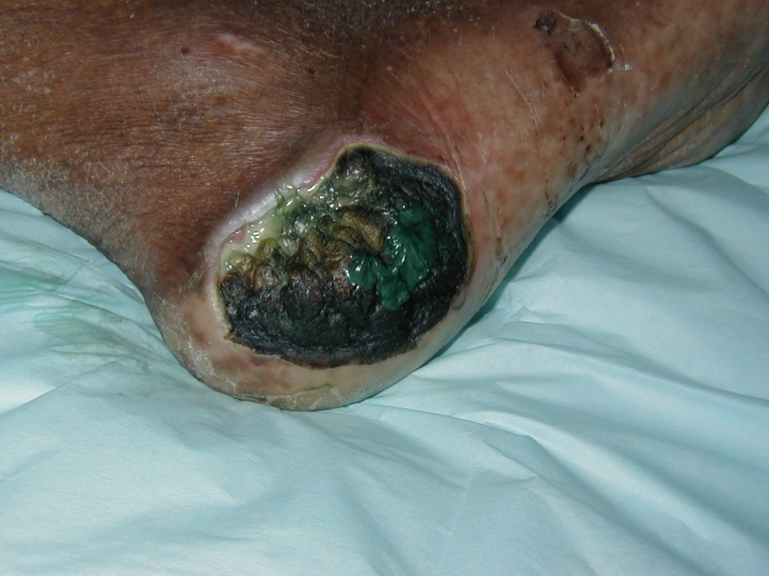
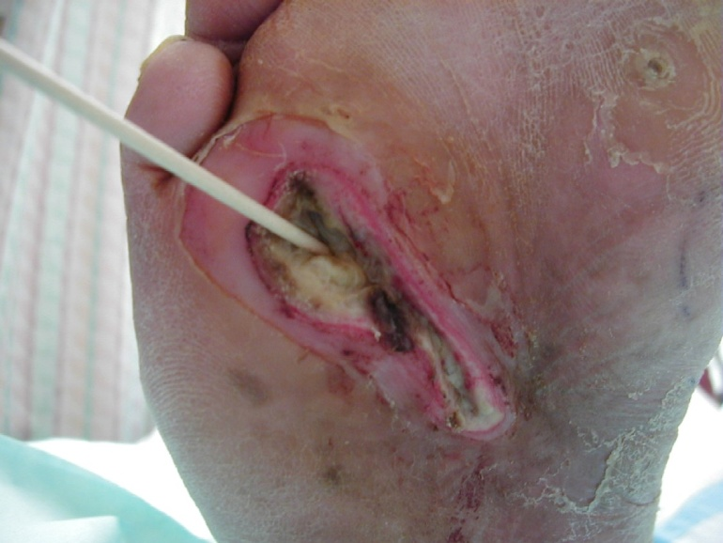
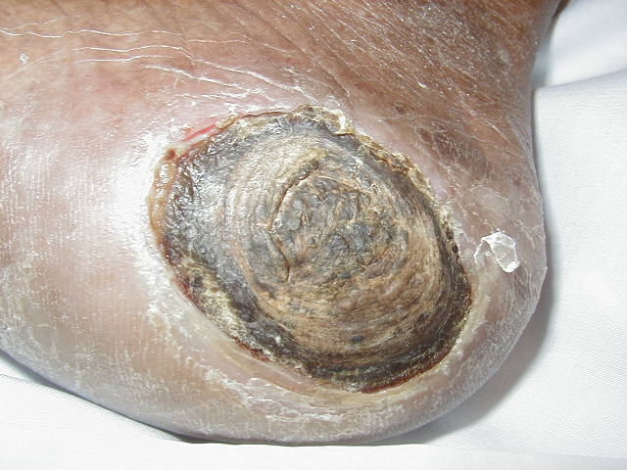
Pressure Ulcer Grading System
Unstageable – Full thickness tissue loss in which the base of the ulcer is covered by slough and/or eschar in the wound bed.

Slide 9
Codes For Skin Replacement Surgery
There are codes for “Surgical Preparation,” formerly called Wound Bed Preparation.
The codes are:
  15002
  15003
  15004
  15005

Slide 10
Codes For Skin Replacement Surgery
CPT 15002 – Surgical Preparation or creation of recipient site by excision of open wounds, burn eschar, or scar (including subcutaneous tissues), or incisional release of scar contracture, trunk, arms, legs; first 100 cm² or 1% of body area of infants and children.
CPT 15003 – Each additional 100 cm² or each additional 1% of body area of infants and children.

Slide 11
Codes For Skin Replacement Surgery
CPT 15004 - Surgical Preparation or creation of recipient site by excision of open wounds, burn eschar, or scar (including subcutaneous tissues), or incisional release of scar contracture, face, scalp, eyelids, neck ears, orbits, genitalia, hands, feet and/or multiple digits; first 100 cm² or 1% of body area of infants and children.
CPT 15005 - Each additional 100 cm² or each additional 1% of body area of infants and children.

Slide 12
New Application Codes for 2012
Codes for Leg
15271 Application of skin substitute graft to trunk, arms, legs, total wound surface up to 100 sq. cm; first 25 sq. cm or less of wound surface.
15272 Each additional 25 sq. cm wound surface area, or part thereof. List separately in addition to code for primary procedure.

Slide 13
New Application Codes for 2012
Codes for Leg
15273 Application of skin substitute graft to trunk, arms, legs, total wound surface greater than or equal to 100 sq. cm; first 100 sq. cm wound surface area, or 1% of body area of infants and children.
15274 Each additional 100 sq. cm wound surface area, or part thereof, each additional 1% of body area of infants and children, or part thereof. List separately in addition to code for primary procedure.

Slide 14
New Application Codes for 2012
Codes for Feet
15275 Application of skin substitute graft to face, scalp, feet, etc., total wound surface area up to 100 sq. cm; first 25 sq. cm or less.
15276 Each additional 25 sq. cm wound surface area, or part thereof. List separately in addition to code for primary procedure.

Slide 15
New Application Codes for 2012
Codes for Feet
15277 Application of skin substitute graft to face, scalp, feet, etc., total wound surface area greater than or equal to 100 sq. cm; first 100 sq. cm wound surface area, or 1% of body area of infants or children.
15278 Each additional 100 sq. cm wound surface area, or part thereof, each additional 1% body area of infants and children. List separately in addition to code for primary procedure.

Slide 16
Skin Replacement Surgery
Tissue cultured epidermal autograft
Cultured autologous skin with only an epidermal layer
HCPCS – Q4100 (NOS)
e.g., CEA, Epicel, EpiDex
Check Medicare LCDs and other insurance policies for coverage of burns

Slide 17
Skin Replacement Surgery
Acellular dermal replacement
A tissue-derived or manufactured device that provides immediate, temp. wound closure & that incorporates into the wound and promotes the generation of a neodermis that can support epidermal tissue
Integra Wound (510 K Clearance for wound care) - Q4108
Check Medicare LCDs and other insurance policies for coverage

Slide 18
Skin Replacement Surgery
Allograft skin
Cadaveric human skin allograft
HCPCS - Q4111
Homograft-skin from skin banks; Gamma Graft (510- K clearance for wound care)
Check Medicare LCDs and other insurance policies for coverage

Slide 19
Skin Replacement Surgery
Acellular dermal allograft
Decellularized allogeneic dermis may require immediate concurrent coverage with autologous tissue
e.g., Alloderm, Graft Jacket (510-K clearance for wound care)
HCPCS code Q4107 (Q4113 for Xpress)
Check Medicare LCDs and other insurance
policies for coverage

Slide 20
Wound Care Code Modifiers
Check Medicare LCD for specific use for:
  KX modifier (Skin substitute products and their application procedures for which the skin substitute was handled, applied, and immobilized appropriately and according to manufacturers’ label instructions)
  JC (Report skin substitute products used as a skin graft
  JD (Report skin substitute products not used as a skin graft)
  JW (Product wasted - discarded)

Slide 21
Skin Replacement Surgery
Tissue cultured allogeneic skin substitute with both a dermal and epidermal layer
e.g., Apligraf (Q4101)

Slide 22
Apligraf
The HCPCS Q4101 supply code for the product can be billed separately x 44 units
15002-15005 & debridement code (11042) included in payment

Slide 23
Skin Replacement Surgery
Tissue cultured allogeneic dermal substitute
Cultured allogeneic neonatal fibroblasts
e.g., Dermagraft (Q4106)

Slide 24
Dermagraft
CPT 15002 (leg) & 15004 (foot/ankle) can be used for “surgical preparation of recipient site”
HCPCS code Q4106 for the product can be billed separately x 37.5 units

Slide 25
Skin Replacement Surgery
Xenogeneic dermis - nonhuman dermis for temporary wound closure
e.g., EZ Derm, Mediskin (510-K approval for wound care) Q4100 (not otherwise specified code)
Check Medicare LCDs and other insurance policies for coverage

Slide 26
Skin Replacement Surgery
Acellular xenogeneic implant – de-cellularized nonhuman connective tissue
Oasis, Surgisis, PriMatrix, MatriStem (510 K approval for wound care)
Check Medicare LCDs and other insurance policies for coverage

Slide 27
Oasis, PriMatrix, Surgisis, and MatriStem
DO NOT USE MODIFIER – 58
HCPCS code for Oasis is Q4102
HCPCS code for PriMatrix is Q4110
HCPCS code for Surgisis & MatriStem is Q4100 (not otherwise specified code)
CPT 1500x & Debridement codes (11042) included

Slide 28
Codes For Skin Replacement Surgery
“These codes are not intended to be
reported for simple graft application alone
or application stabilized with dressings
(e.g., by simple gauze wrap). ”
“The Skin substitute/graft is anchored using
the surgeon’s choice of fixation. When
services are performed in the office, the
supply of the skin substitute/graft should
be reported separately. Routine dressing
supplies are not reported separately.”

Slide 29
Reimbursement for Advanced Wound Care Modalities
FDA approval (PMA vs. 510 K)?
  Premarket approval vs. premarket notification of a “new” device.

Slide 30
Common Products used for Advanced Wound Care
Product | Approval | CPT Codes | Global | LCD Coverage
Apligraf | PMA (VLU and DFU) | 15271 - 15278 | 0 - day | VLU and DFU
Dermagraft | PMA (DFU) | 15271 - 15278 | 0 - day | DFU; use of -58 modifier varies
Oasis | 510K | 15271 - 15278 | 0 - day | Limited coverage
Integra | 510K | 15271 - 15278 | 0 - day | Limited coverage
Graftjacket | 510K | 15271 - 15278 | 0 - day | Limited coverage

Slide 31
Change in Wording + New Code
11042 Debridement, subcutaneous tissue (includes epidermis and dermis, if performed); first 20 cm² or less
Add-on:
11045 each additional 20 cm², or part thereof

Slide 32
Change in Wording + New Code
11043 Debridement, muscle, and/or fascia (includes epidermis, dermis, and subcutaneous tissue, if performed); first 20 cm² or less
Add-on:
11046 each additional 20 cm², or part thereof

Slide 33
Change in Wording + New Code
11044 Debridement, bone (includes epidermis, dermis, subcutaneous tissue, muscle and/or fascia, if performed); first 20 cm² or less
Add-on:
11047 each additional 20 cm², or part thereof

Slide 34
CMS & Debridement
Many CMS medical directors have expressed in their LCDs that there should be a limited frequency of use for CPT 11043 & 11044.
Place of Service has also come into question by these CMS medical directors.
Read your LCD.

Slide 35
97597 - 97598
Provider is required to have direct (one-on-one) patient contact.
97597 Removal of devitalized tissue from wound(s), selective debridement, without anesthesia (eg, high pressure waterjet with/without suction, sharp selective debridement with scissors, scalpel and forceps), with or without topical application(s), wound assessment, and instruction(s) for ongoing care, may include use of a whirlpool, per session; total wound(s) surface area; first 20 cm².
97598 each additional 20 cm².

Slide 36
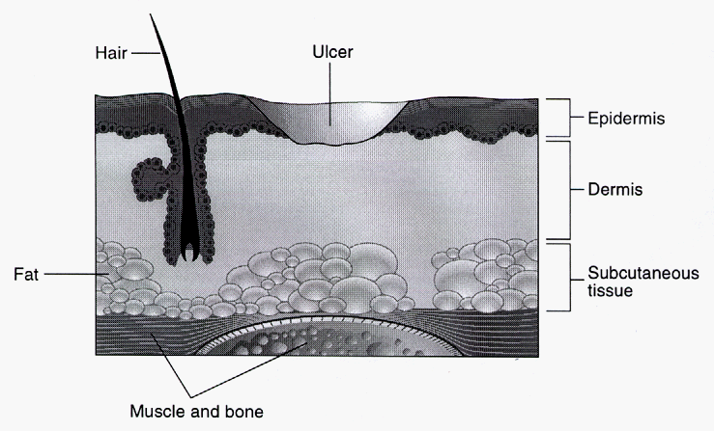
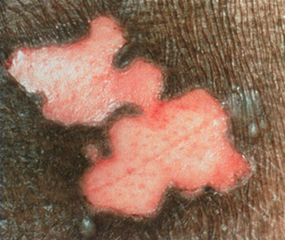
Partial Thickness – Only Epidermis

Slide 37
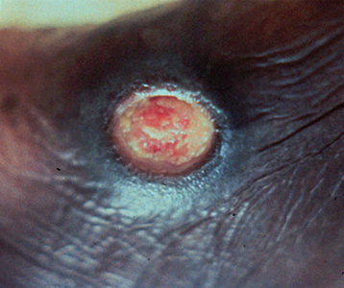
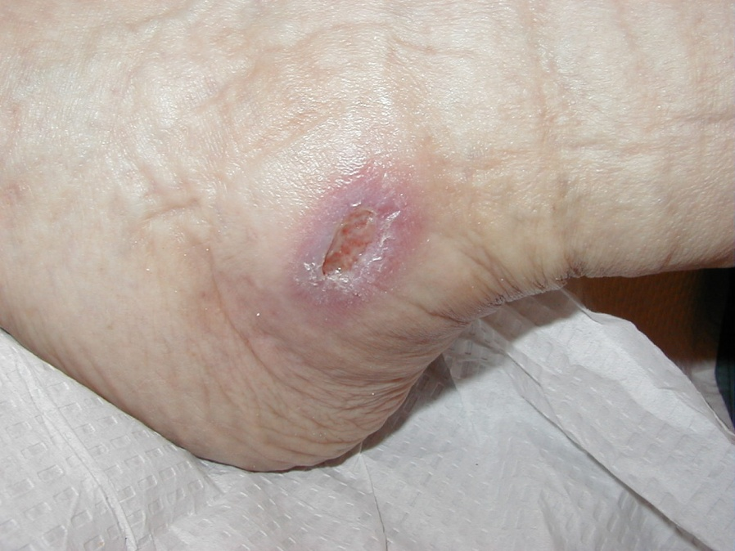
Full Thickness – Epidermis & Dermis

Slide 38
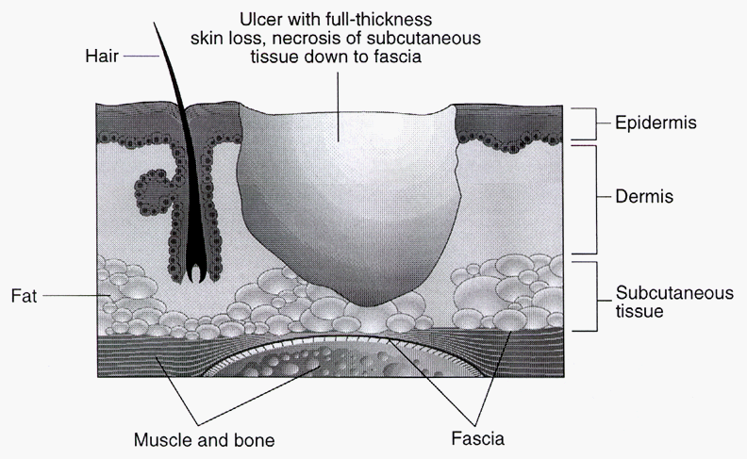
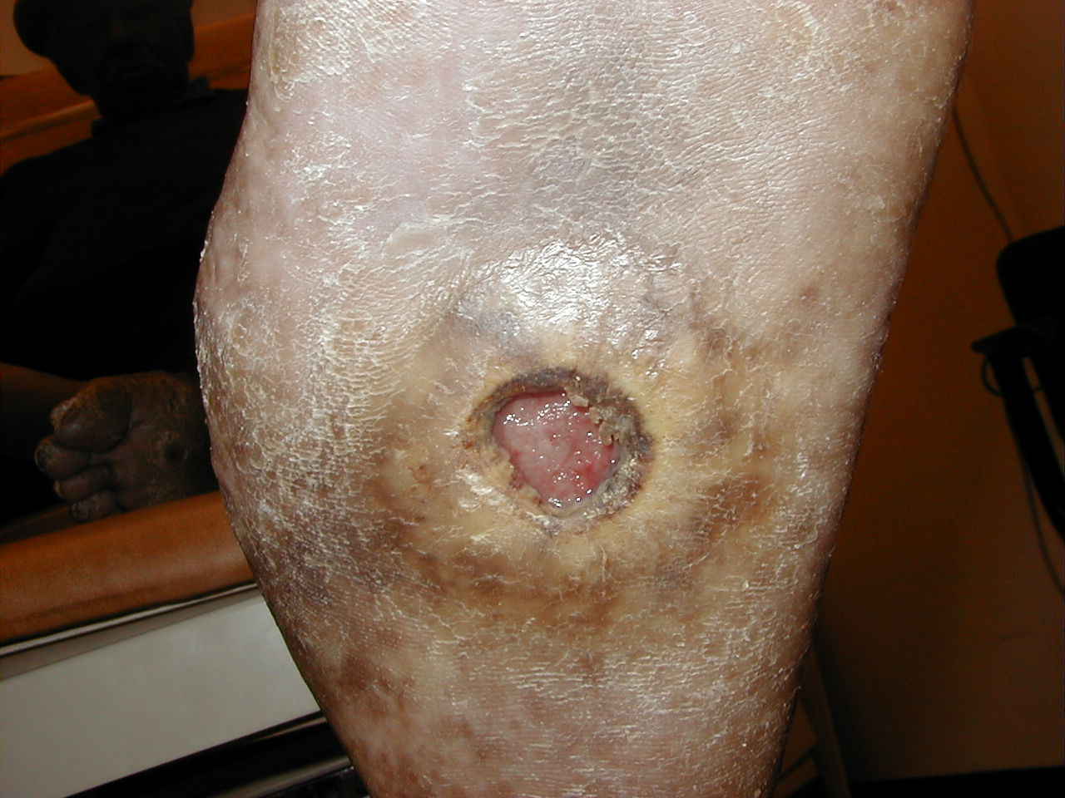
Full Thickness & Subcutaneous Tissue

Slide 39
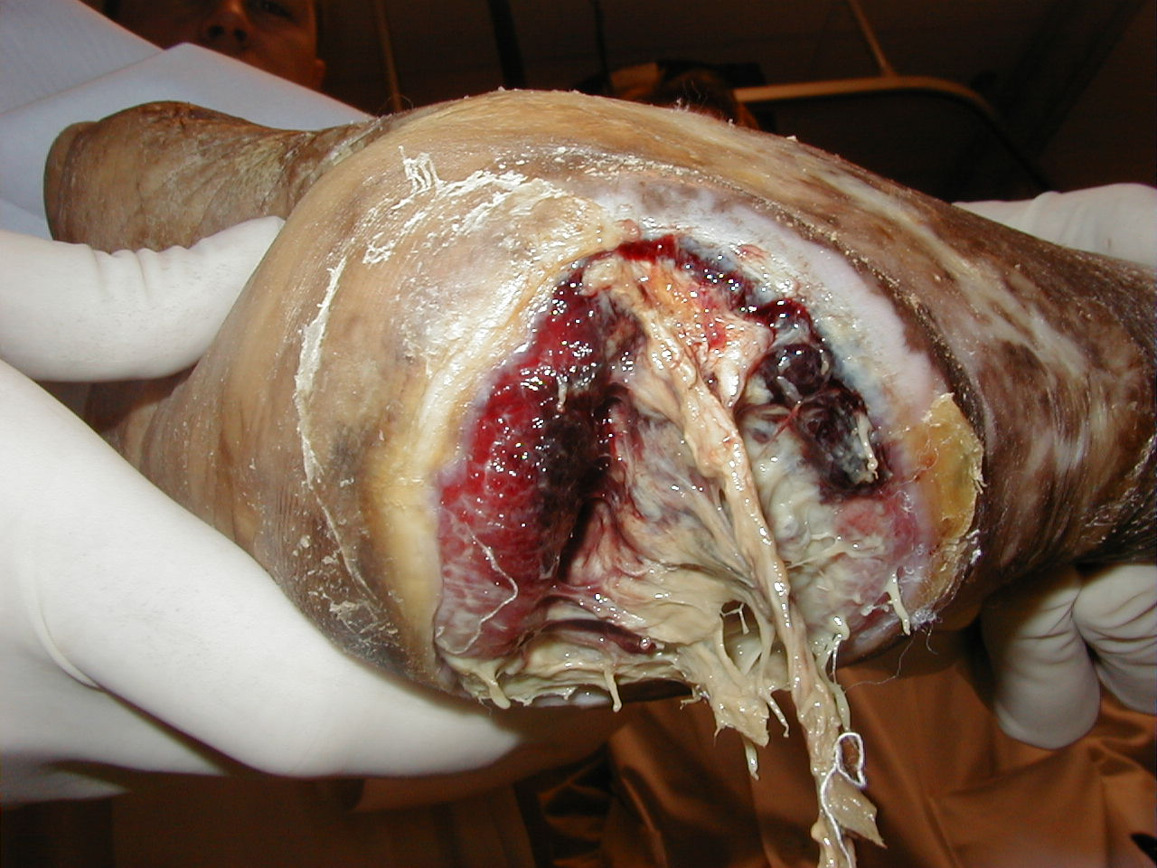
Full Thickness, Subcutaneous Tissue & Muscle

Slide 40

Full Thickness, Subcutaneous Tissue, Muscle, & Bone

Slide 41
Role of Debridement
Debridement must remove all necrotic soft tissue. This removes
senescent cells from the wound.
Debridement may aid by removing tissue with the highest bacterial
counts, thereby bringing the wound into bacterial balance.
Debridement can activate platelets to release the contents of their
alpha granules. The released growth factors stimulate the
inflammatory response that is believed to play an important role in
wound healing. Formation of new granulation tissue following
debridement may also help to perpetuate the wound healing
cascade.
An additional advantage of debridement is that it allows for a more
thorough investigation of the degree of penetration and can detect
inadequately treated infection. Pockets may be unroofed or
saucerized to allow pus to drain freely. After debridement, the ulcer
will usually be larger than it was at presentation

Slide 42
Other Codes for Wound Care
11000 – Debridement of extensive eczematous or infected skin; up to 10% of body surface
  This code was deleted in 2011
  Typically a code used primarily for dermatological purposes
  Should be used sparingly in diabetic, venous stasis, and pressure ulcers
  0-day global
  Not typically a “podiatric” code

Slide 43
Other Codes for Wound Care
20000 – has been deleted in 2011
20005 – Incision and drainage of soft tissue abscess, subfascial, (ie, involves the soft tissue below the deep fascia) (verbiage changed)
  These codes may be used in conjunction with a diagnosis of osteomyelitis
  10-day global

Slide 44
Other Codes for Wound Care
27603 – Incision & drainage, leg or ankle; deep abscess or hematoma
27607 – Incision (e.g., osteomyelitis or bone abscess), leg or ankle
27640 – Partial excision (craterization, saucerization, or diaphysectomy) bone (osteomyelitis or exostosis); tibia
27641 – fibula
  These codes have a 90-day global

Slide 45
Other Codes for Wound Care
28120 – Partial excision (craterization, saucerization, or diaphysectomy) bone (osteomyelitis or bossing); talus or calcaneus
28122 – tarsal or metatarsal bone, except talus or calcaneus
28124 – phalanx of toe
  These codes have a 90-day global

Slide 46
Other Codes for Wound Care
28002 – Incision and drainage below fascia, with or without tendon sheath involvement, foot; single bursal space
  10-day global
28003 – multiple areas
  90-day global
28005 – Incision, bone cortex (e.g., osteomyelitis or bone abscess), foot
  90-day global

Slide 47
Negative Pressure Wound Therapy Codes
97605 – NPWT (vacuum assisted drainage collection), including topical application(s), wound assessment, and instruction for ongoing care, per session; total wound(s) surface area less than or equal to 50 cm²
97606 – total wound surface greater than 50 cm²
Selective debridement and dressings are INCLUDED in these codes
FDA warning about bleeding complications – Document that you have explained this to your patient

Slide 48
Unna Boot Code
29580 – Unna Boot
This is “officially” listed in the “casting and strapping” section of CPT and, therefore, it is not considered a bandage and is separately billable

Slide 49
Multi-Layer Compression System – NEW CPT CODE for 2010
For multi-layer compression dressing, also known as a “high compression bandage system” (Profore, DynaFlex), the NEW CPT code is 29581.

Slide 50
Reimbursement for Advanced Wound Care Modalities
Always check your LCD for coverage and payment variations
  There are many inconsistencies for products and procedures from payer to payer
Products and procedures with consistent coverage are typically safe, effective, and provide multiple patient and physician benefits

Slide 51
Platelet Rich Plasma
Category III (tracking) code - 0232T
Effective as of 1/01/2010
0232T – Injection(s), platelet rich plasma, any tissue, including guidance, harvesting and preparation when performed
A high-quality study just published in JAMA showed that platelet rich plasma was not effective in treating Achilles tendinitis

Slide 52
Questions

