Slide 1
Calcaneal Apophysitis
Mom/Dad my foot hurts!
Kim Heineman, PMAC

Slide 2
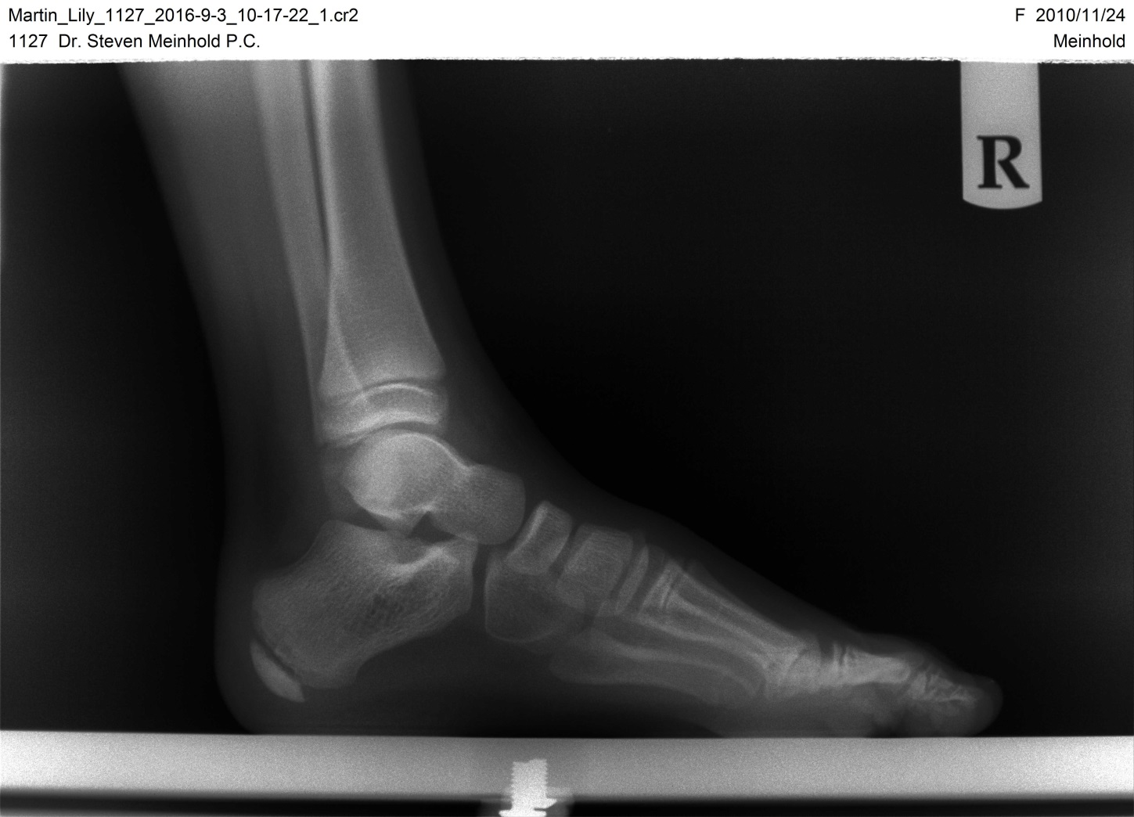
What is it?
Inflammation of the growth plate in the heel

Slide 3
What is it?
Also called Sever’s disease, named after Dr. James Sever
Usually occurs during a growth spurt in adolescence
Boys ages 10-15
Girls ages 8-13
Typically higher occurence in boys

Slide 4
Causes
Stress on the heel, overuse or repetitive trauma
Children active in sports
Obesity
Tight Achilles tendon
Foot deformity such as flat feet or high arch

Slide 5
Symptoms
Symptoms may include:
Chief complaint of pain in one or both heels
Tenderness without injury
Increased pain while running or jumping
Limping or walking on toes

Slide 6
Diagnosing
Examination
X-rays to rule out another condition
Squeeze test

Slide 7
Treatment
Reducing activity that causes pain
Cushion and support for the heel
Anti-inflammatory medications
Stretching and icing
Immobilization

Slide 8
Prevention
Educating parents and coaches
Proper shoes
Stretching and icing
Heel pads or lifts
Arch supports

Slide 9
Conclusion
Calcaneal apophysitis is an inflammation of the growth plate in the heel and is a temporary condition that occurs during adolescence and a time of rapid growth.
It can be treated and managed fairly easily
Does not cause any long term conditions or problems
Will go away without reoccurance once the growth plate in the heel has closed.

Slide 10
Questions?

