Slide 1
Getting A Patient Through Surgery
By: Destiny Gomez, PMAC
American Society Of Podiatric Medical Assistants

Slide 2
The Assistants Role
The assistant is the individual who will be there to help the patient get through surgeries either by assisting the doctor or by being there to support and assist the patient

Slide 3
Pre-Op Visit
Aidet
Vitals
Family History
Medications
Allergies
Smoking status
X-ray

Slide 4
The High Risk Patient
There are certain patients who are identified as “high risk” patients. They are labeled as such because of medical conditions hat place their limbs in jeopardy. If these patients do not receive proper medical care, they may develop infections or wound that do not heal. When this occurs, they are in jeopardy of loss of limb.

Slide 5
The High Risk Patient
Professional and diligent care is warranted for these patients. Patients in this category include:
Patients with peripheral vascular disease
Patients with peripheral neuropathy
Patients with diabetes
Patients that smoke
Patients on anti-coagulant therapy

Slide 6
Surgical Checklist
Primary Care Provider
H&P
Dates available
Up to date demographics

Slide 7
Insurance Verification
Up to date insurance cards
Ensure notes are dictated
CPT codes & ICD codes for the surgical procedure
DPM'S NPI, Hospital or Physician’s Tax ID
Outpatient Vs. Inpatient
Type of anesthgia

Slide 8
Post-Operative Appointment
There are times when the patients feel more comfortable talking to the assistant than they do the doctor and will confide in us before they do the doctor.
Document everything

Slide 9
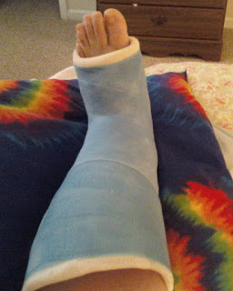
Inform The Patient What To Expect Post Op
Durations
Weight bearing Status
Pain
Elevating
Crutches, wheelchair, knee walker
Dressing care

Slide 10
Complications
Pain
Infection
Swelling
Sensory Changes
Scarring
Delayed Healing
Blood Clots

Slide 11
Complications
Patients with complications are worried, fearful, and insecure about what is happening and why. This is especially true for post surgical complications. The patient needs a step-by-step explanation as to the cause of the complication, the expected time for complete recover, plan of treatment and any permanent damage or need.

Slide 12
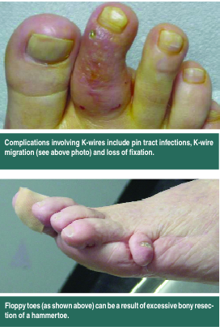
Signs of Infection
Redness
Swelling
Pus
Extreme pain
Fever
Chills
Nausea
Vomiting
Shortness of breath

Slide 13
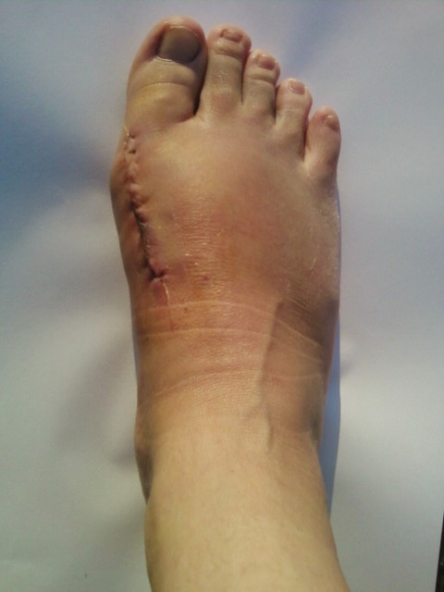
C0mpliance
Non-Smoker
Non-weight bearing
Elevating
Icing
Taking vitamins
Keeping dressing dry and intact

Slide 14
Non Compliance
Smoker
Walking
Injuries
Not taking prescribed medications
Wet dressings
Uncontrolled blood sugars

Slide 15
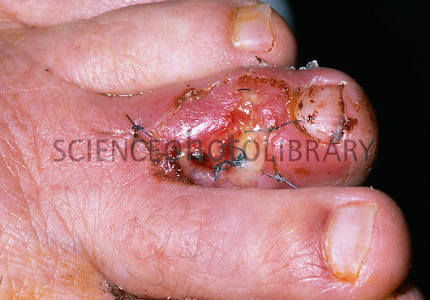
Results From Non Compliant Patients
Infection
Wound Vac
Amputation
Delayed Healing
Graft placement

Slide 16
Expectations from Surgery
Pain-Free
Able to ambulate within 8-12 weeks
Get back to a normal life

Slide 17
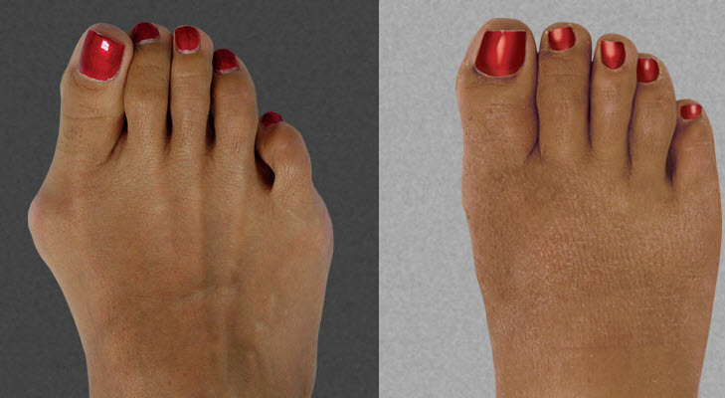
CASE REPORT #1
46 yo female patient presents to your office complaining of a very prominent and painful bunion on her left foot. She states that she has tried the orthotics you prescribed her for 1 year; however, she still has a lot of pain and relates that she would like to move forward with surgical intervention to correct the deformity.
As a podiatry assistant, what would be your first course of action?
Patient states she would like for surgery to be scheduled next month and relates that she quit smoking the 1 pack daily exactly 2 months ago, what would be your next course of action?

Slide 18
Any Questions?

